Slide 2
SciENcv: PI to Research Admin – An Overview
Annie Studer, Grants & Contracts Specialist – Proposals, RSP
Alex Delvoye, Research Administrator, Mechanical Engineering Department

Slide 3
With SciENcv PI’s are more involved
PI responsibilities
  Create SciENcv account - https://www.ncbi.nlm.nih.gov/sciencv/
  Delegate access to research administrator
  Certify documents
Research Admin responsibilities
  Update biosketch and current and pending as needed
Notes:
Annie

Slide 4
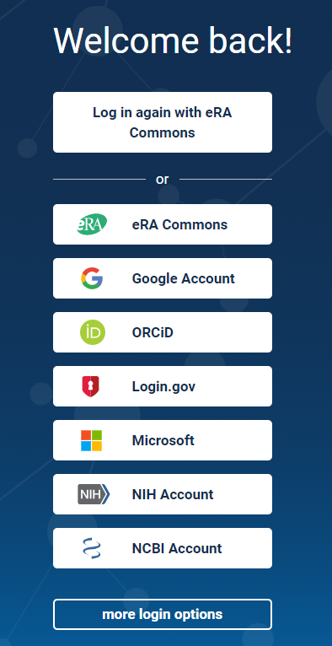
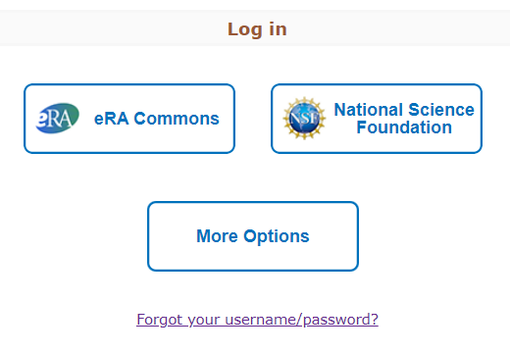
Login Difficulties: Remember
How You Login
https://www.ncbi.nlm.nih.gov/sciencv/
Select same login option every time to find your documents
Tip: Write down or note if your PI tells you how they log in so you can help them remember
Notes:
Alex

Slide 5
Login Difficulties: Using NSF Login
The NSF login option will take the user to the NSF website to login
The user will need to navigate themselves back to: https://www.ncbi.nlm.nih.gov/sciencv/
Notes:
Alex

Slide 6
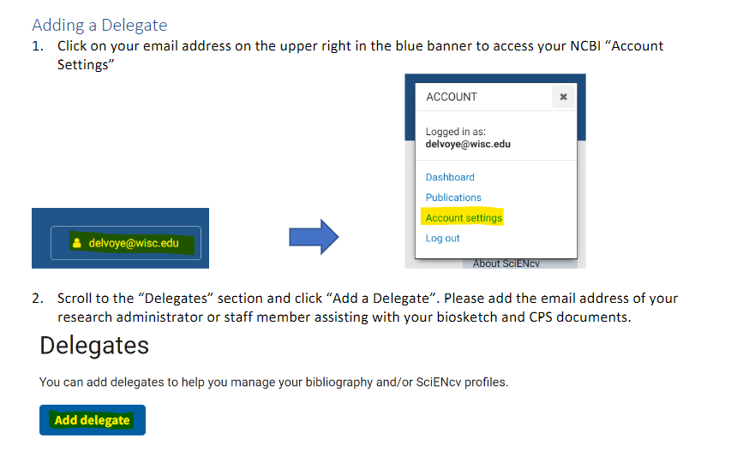
Delegating Access to RAs
The PI needs to delegate, department admins CANNOT add themselves.
Notes:
Annie

Slide 7
Delegating Access to RAs
Delegation can be given across departments and there is no limit as to the number of delegates that can be added
https://www.ncbi.nlm.nih.gov/sciencv/
^^live demo
https://uwmadison.app.box.com/file/1674667306851
^^how-to also printed
Notes:
Annie

Slide 8
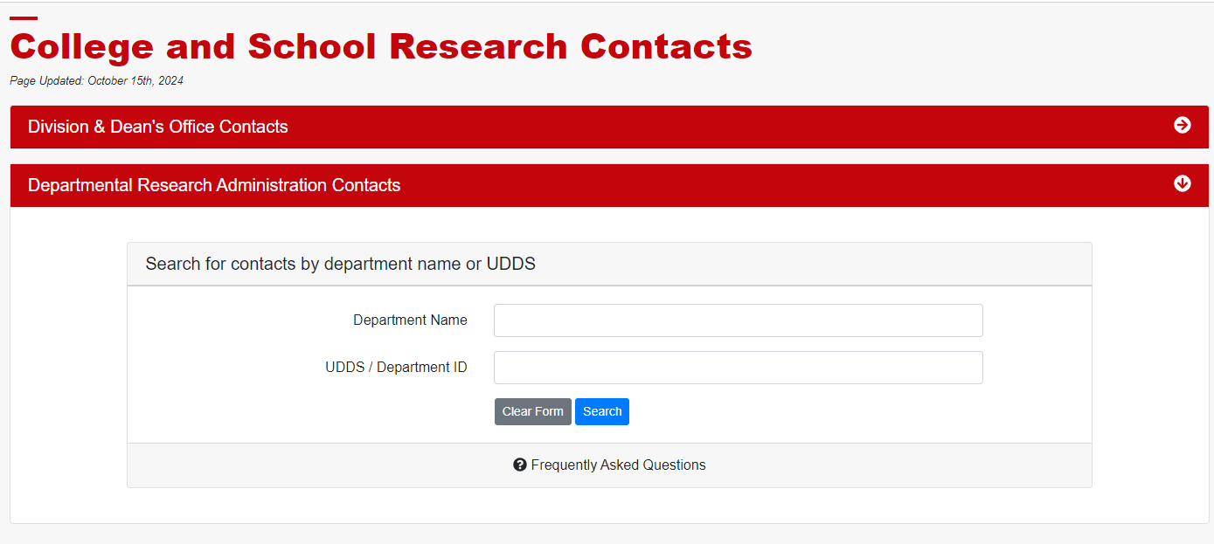
Finding Contacts
Find your Dean's Office and Departmental Research Administration contacts: https://rsp.wisc.edu/ResearchContact/
Best to search generally e.g. "Mechanical" or "Center"
Notes:
Annie

Slide 9
Review the NOFO for Proposal First!
REMINDER: Review NOFO to determine if you can use SciENcv for biosketch and current and pending documents
Some sponsors request additional information that is not captured on the common form meaning you can't use SciENcv:
  Sponsor grant contact information and address
  Effort in percentage
  Direct and indirect costs by year
Notes:
Alex

Slide 10
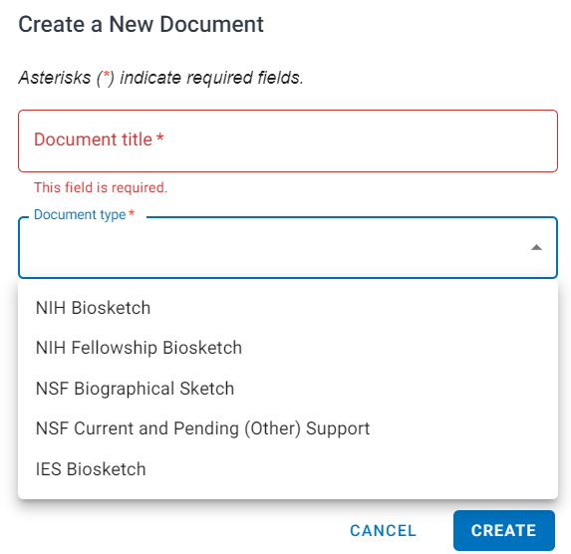
Other Support in SciENcv
Common Forms were developed by the National Science and Technology Council's Research Security Subcommittee
  NSF Biographical Sketch
  NSF Current and Pending Support
The National Science Foundation (NSF) acts as the steward for these forms
Other documents generated in SciENcv
  NIH Biosketch
  NIH Fellowship Biosketch
  IES Biosketch
Notes:
Annie

Slide 11
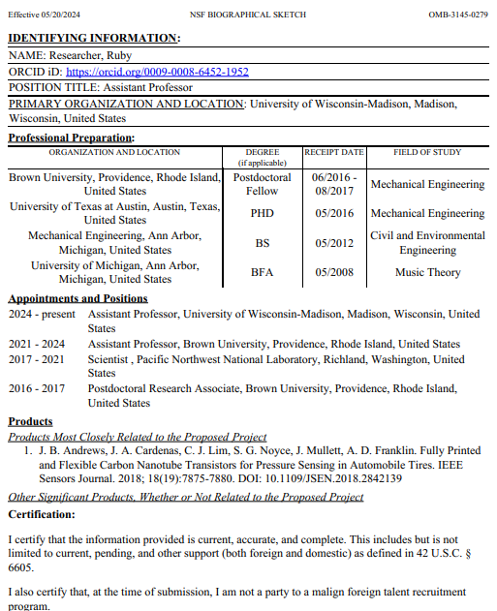
Biosketch
Identifying information (name, position title, ORCID ID)
Professional Preparation (e.g., education and training)
Appointments and Positions
Products
  5 products most closely related to the proposed project
  5 other significant products, whether or not related to proposed project
Notes:
Alex

Slide 12
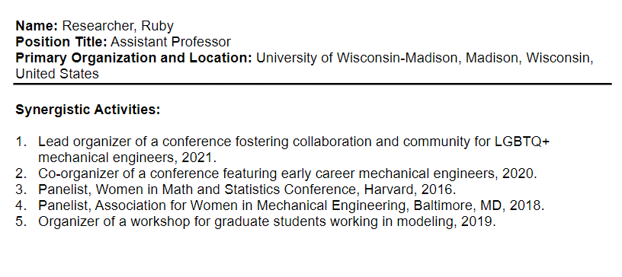
Biosketch – Synergystic Activities
Note: Biographical Sketch no longer includes Synergistic Activities
Upload as separate document for NSF proposals
Notes:
Alex

Slide 13
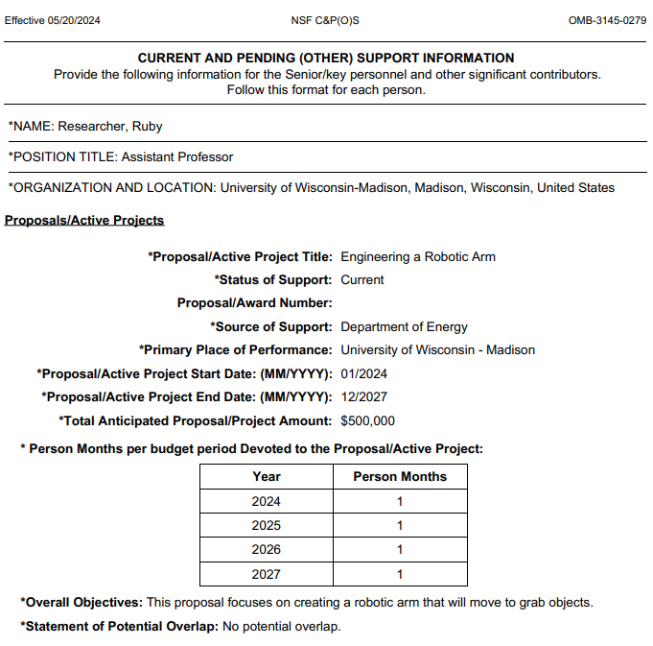
Current and Pending Support
Identifying information (name, position title, ORCID ID)
Proposals/active projects
In-kind contributions
Notes:
Alex-what department is looking for
Annie-what RSP is looking for

Slide 14
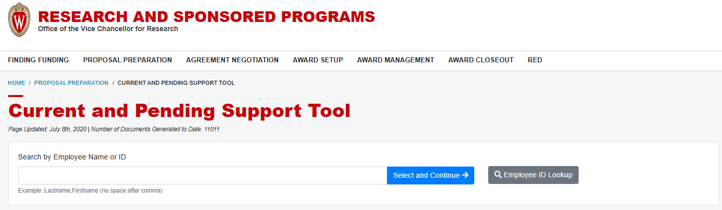
Current and Pending Support
Notes:
Annie

Slide 15
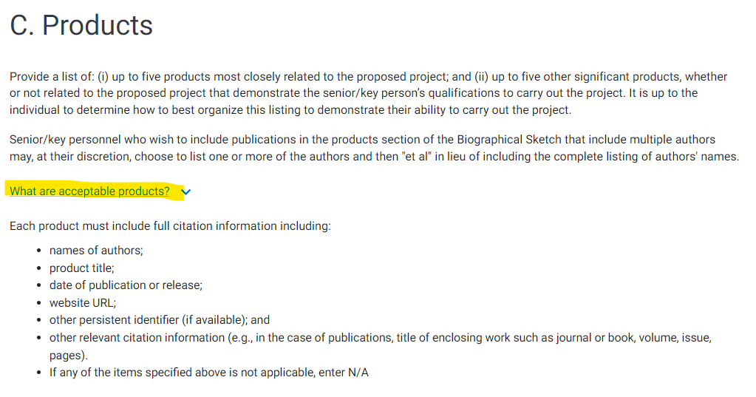
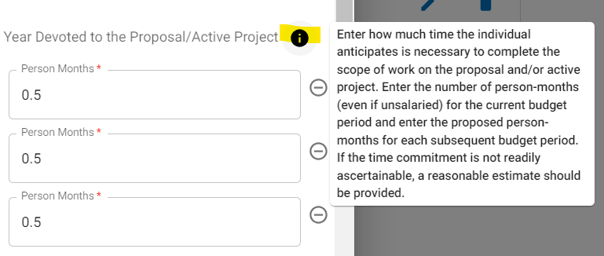
SciENcv Help Text for Questions
Notes:
Alex

Slide 16
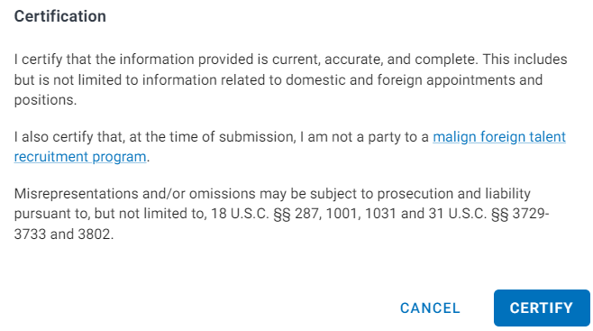

Certification Statement
PIs must certify their biosketch and current and pending support by downloading the PDF from SciENcv
Research administrators cannot download document without PI certification
Notes:
Annie-what certification means legally, malign foreign recruitment

Slide 17
ORCID ID Connection
Some sponsors (NIH, DOE) are starting to require ORCID ID on biosketch and current and pending support by May 2025
Encourage your PIs to connect their ORCID ID to SciENcv early
UW–Madison Libraries offer ORCID support. You can refer researchers to the Libraries’ ORCID support page if they need help creating or managing their ORCID accounts
Notes:
Alex

Slide 18
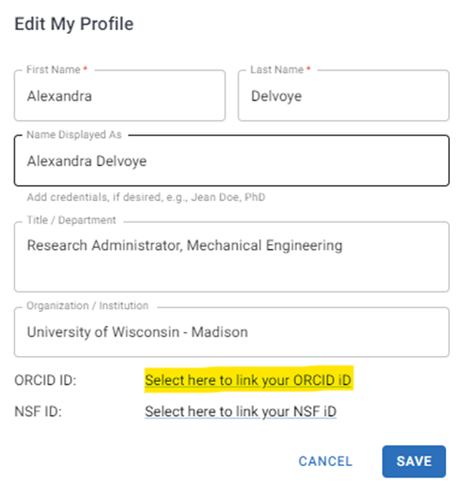
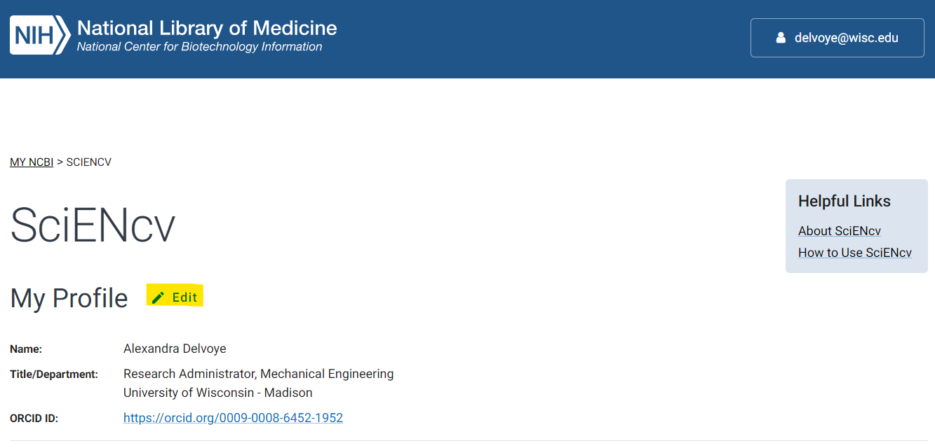
ORCID ID Connection – 2 Ways to Connect
Add ORCID to SciENcv Profile
  Will show up on newly generated blank documents
Notes:
Alex

Slide 19
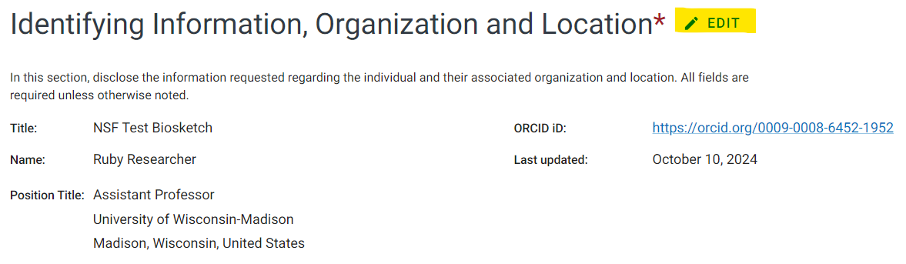
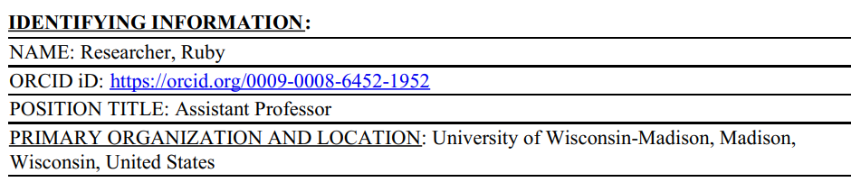
ORCID ID Connection
Add ORCID to already existing documents
  Enter document and "Edit" Identifying Information section
Notes:
Alex

Slide 20
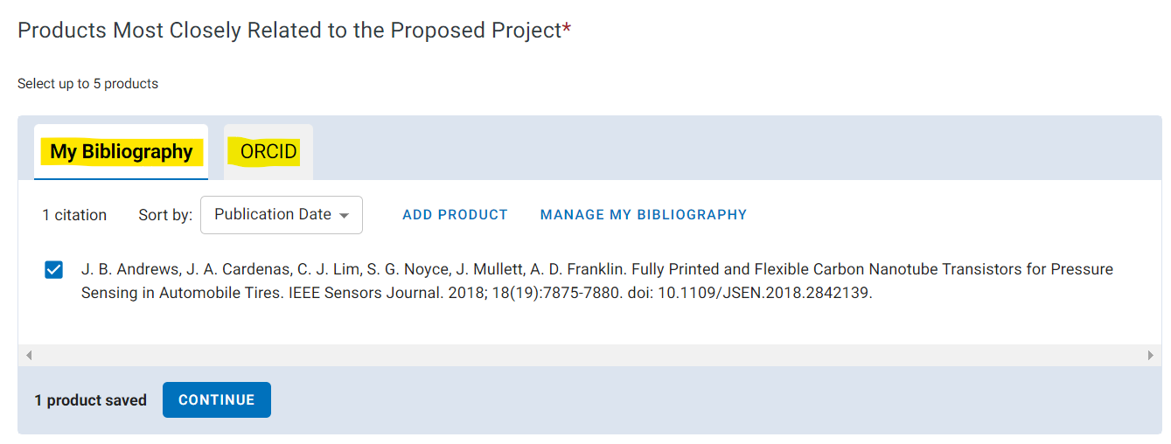
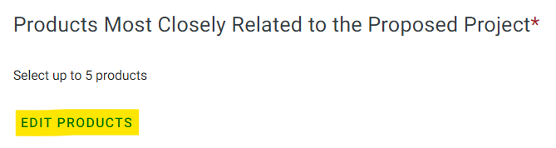
Products – ORCID ID and My Bibliography
Access publications from the PI's My Bibliography or ORCID accounts
  PI or delegate must add citations to My Bibliogrpahy
  ORCID ID can automatically add publications or PI can add them to their account
Notes:
Alex

Slide 21
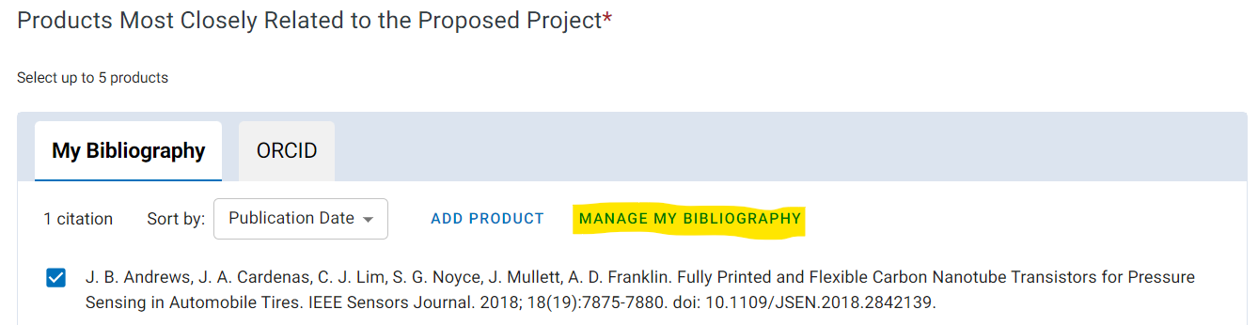
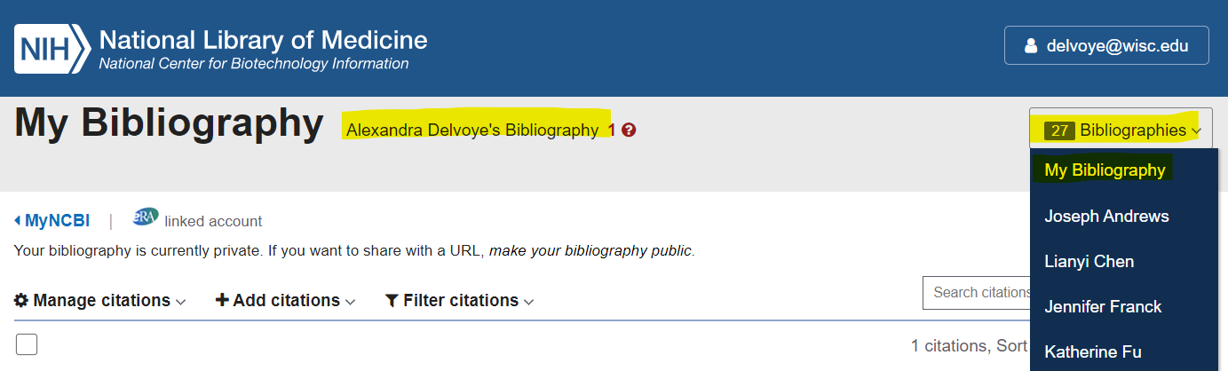
My Bibliography - Accessing PI Citations
Notes:
Alex

Slide 22
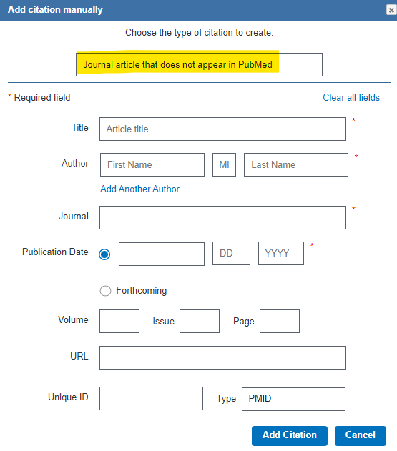
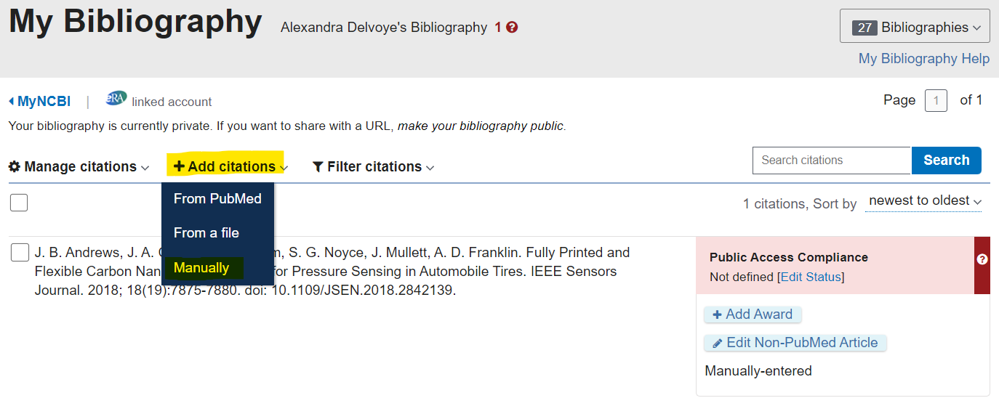
My Bibliography – Manually Adding Citations
Notes:
Alex

Slide 23
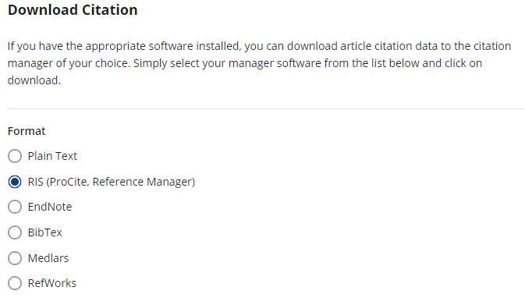


My Bibliography - Download Citations
Search for publication using Google
  May be on journal's website, ResearchGate, etc.
  Find the option to download the citation somewhere on website
Download citation in RIS format
Notes:
Alex
Example: download citation link under "abstract" https://iopscience.iop.org/article/10.1088/2399-1984/ad36ff

Slide 24
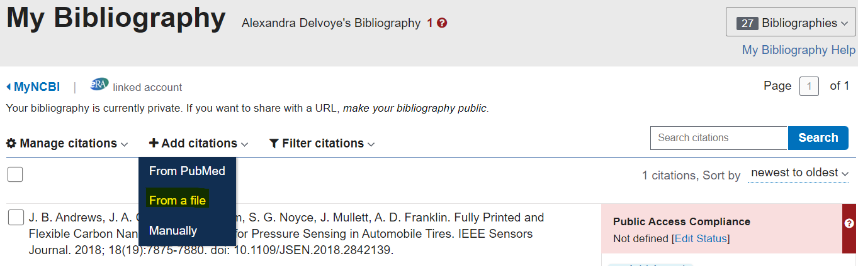
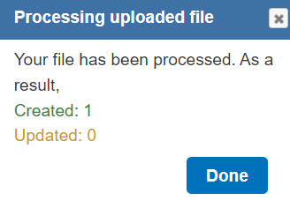
My Bibliography - Download Citations
Upload "From a file" into My Bibliography
Go back to SciENcv biosketch and citation will be available to select as a product under "My Bibliography"
Notes:
Alex

Slide 25
NIH – What Should We Expect?
https://grants.nih.gov/policy-and-compliance/changes-coming-2025/common-forms-for-biosketch
Applicants and recipients must use Common Forms for application due dates and report submission dates on or after May 25, 2025.
Familiarize yourself prior to May 25th, 2025 in order to meet requirements of SUBMISSIONS
Forms will be required NOT when you create application package but WHEN it's actually submitted.
Notes:
Annie

Slide 26
Questions?
Annie Studer (annie.studer@rsp.wisc.edu)
Alex Delvoye (delvoye@wisc.edu)

